Slide 1

Clinical Trial Recruitment
Team Film Festival Locarno Riad Beqiri Janick Marti Navneet Kaur Pawanpreet Kaut
Notes:
Bildbetrachtung zur Einleitung:
Viele kleine, langsame, weiss gefährte ohne viel sicherheitsausstattung
Wenige fahrräder
Nutzungsmix
Shuttle hält auf Veloweg
Es ist schön wetter.

Slide 2
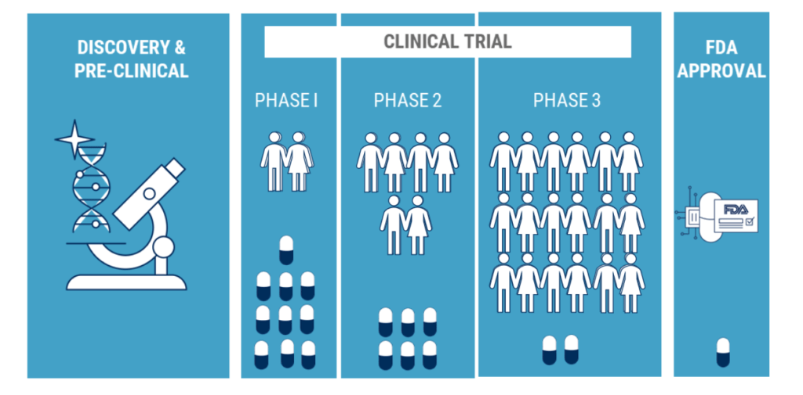
digitalisation of business Processes
Clinical Trials
10 - 100 healthy volunteers
50 – 500 volunteers with disease
Thousands of patients with disease
Clinical Trials
Research study conducted in human beings with the goal of answering specific questions about new therapies, vaccines, diagnostic procedures or drugs.
Phase I: Human Pharmacology «first in human»
Phase II: Therapeutic Exploratory
Phase III: Therapeutic Exploratory
Phase IV: Post approval Lifecycle management
Source: cbinsights.com
Safety
Safety & Efficacy
Efficacy

Slide 3




digitalisation of business Processes
Clinical Trial Recruitment
CHALLENGES
RECRUIT THE RIGHT PEOPLE FOR THE TREATMENT
A LOT OF MANUAL WORK INVOLVED
IMPROVE DATA QUALITY CONTROL BY USING DIGITAL DATA
LEVERAGE PATIENTS HISTORY AND PAST TRIAL RESULTS

Slide 4
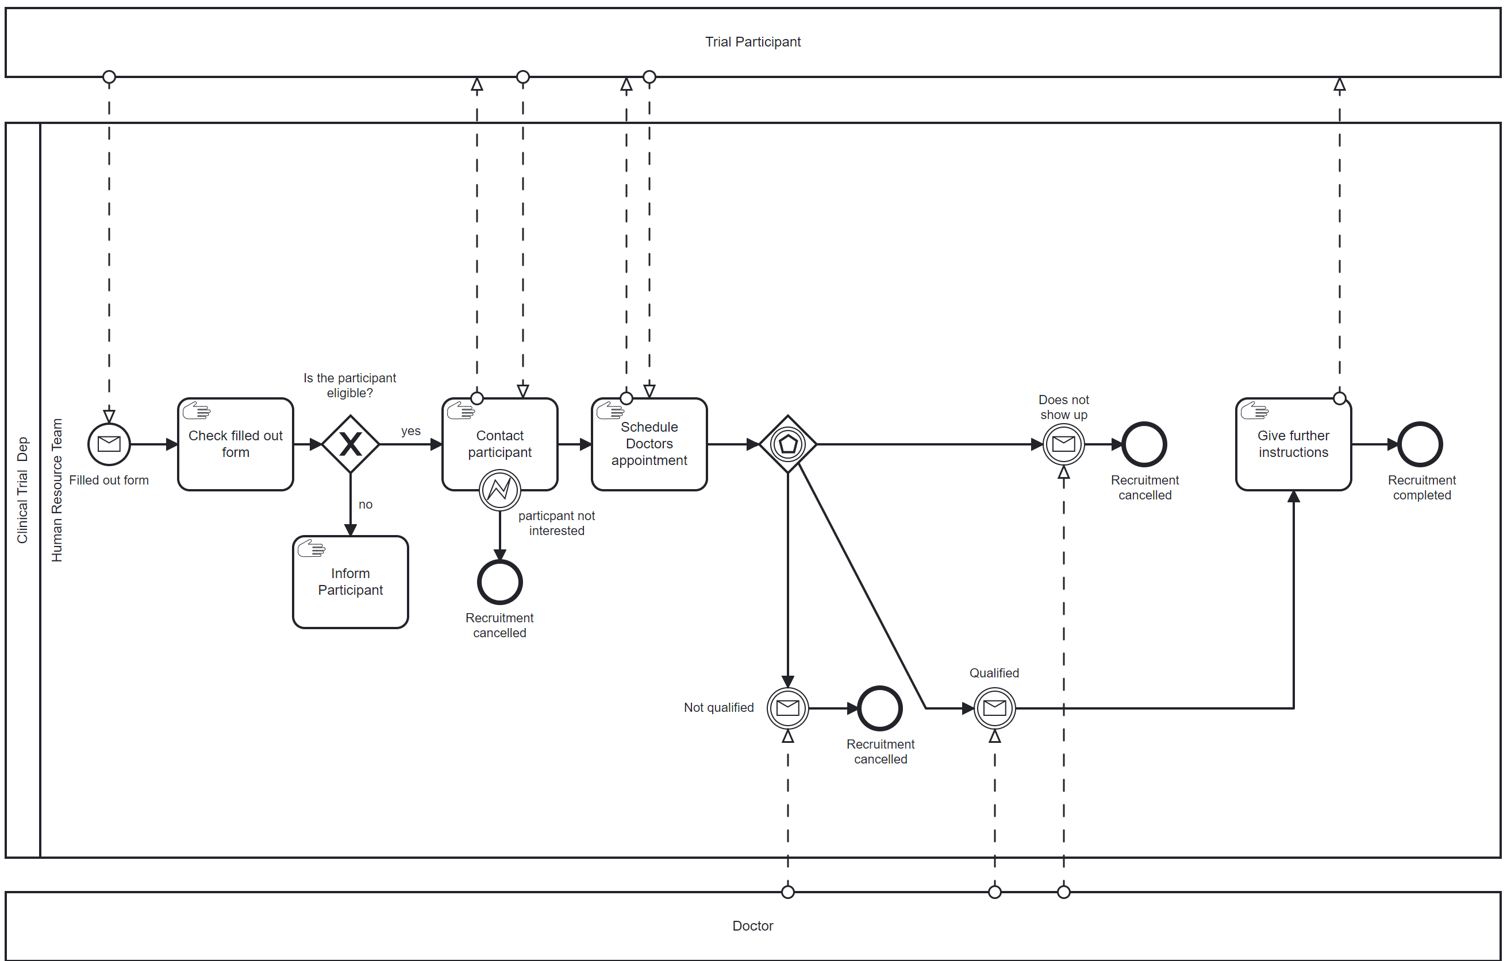
digitalisation of business Processes
AS-IS Process

Slide 5
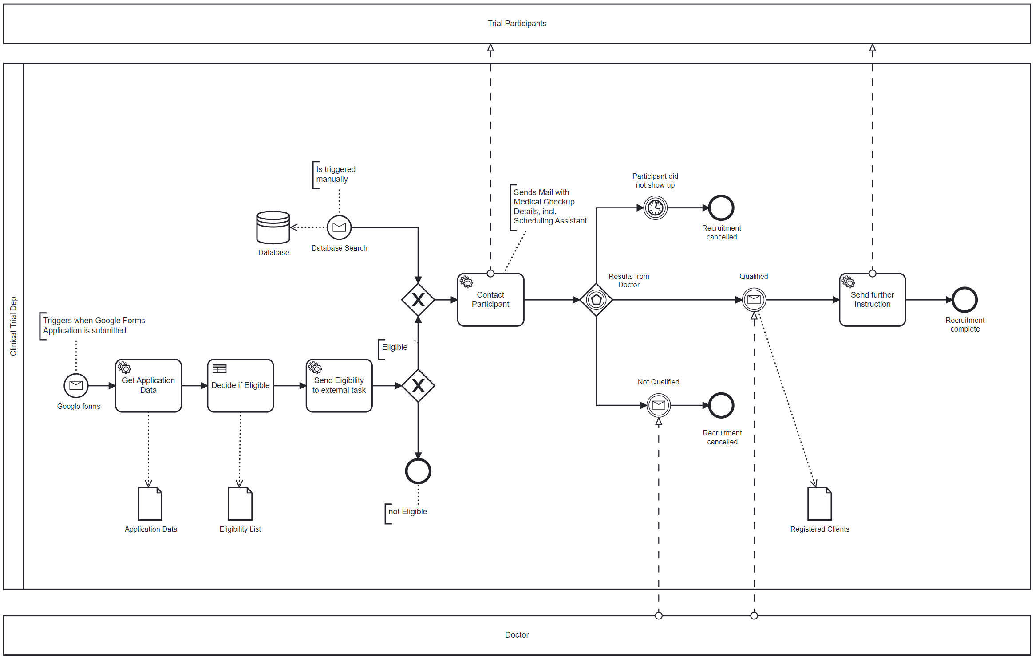
digitalisation of business Processes
TO-BE Process

Slide 6

digitalisation of business Processes
VIDEO PRESENATION
LETS SWITCH TO THE VIDEO PRESENTATION OF OUR PROCESS

